Slide 1
SECURE DATA HIDING IN IMAGES USING STEGANOGRAPHY
CAPSTONE PROJECT
Presented By: M. Siva Shankar
Student Name : M. Siva Shankar
College Name & Department : P, R, Government Degree College .& Computer Science Department

Slide 2
OUTLINE
Problem Statement
Technology used
Wow factor
End users
Result
Conclusion
Git-hub Link
Future scope

Slide 3
Problem Statement
"In today's digital age, the need for secure communication and data concealment is paramount."
"Traditional encryption methods can sometimes draw unwanted attention."
"Steganography offers a discreet way to embed sensitive information within seemingly innocuous files,
like images."
"The problem is to create a simple and secure way to hide text messages within an image, and
retrieve them with a passcode."

Slide 4
Technology used
Python: For implementing the core logic.
OpenCV: A library used for image manipulation and processing.
Steganography: The technique of hiding secret messages in images without altering the image's appearance.
Encryption: Using a password-based system to securely decrypt the hidden message.
IDE: An Integrated Development Environment (IDE) like VS Code for coding.

Slide 5
Wow factors
The message is hidden within the image itself, making it imperceptible to the naked eye.
Encryption ensures that the hidden message can only be accessed by someone who knows the
correct passcode.
This project combines both cryptography and steganography, offering a unique and secure method for
message transmission.
The image remains unchanged in appearance, yet it carries a hidden secret, creating an elegant
solution for secure communication.

Slide 6
End users
Personal Users: Individuals looking for secure communication methods for private messages.
Business Professionals: Secure exchange of confidential information.
Government Agencies: For high-security applications, such as exchanging sensitive data in a
covert manner.
Hackers/Cybersecurity Professionals: To test and improve data protection measures.

Slide 7

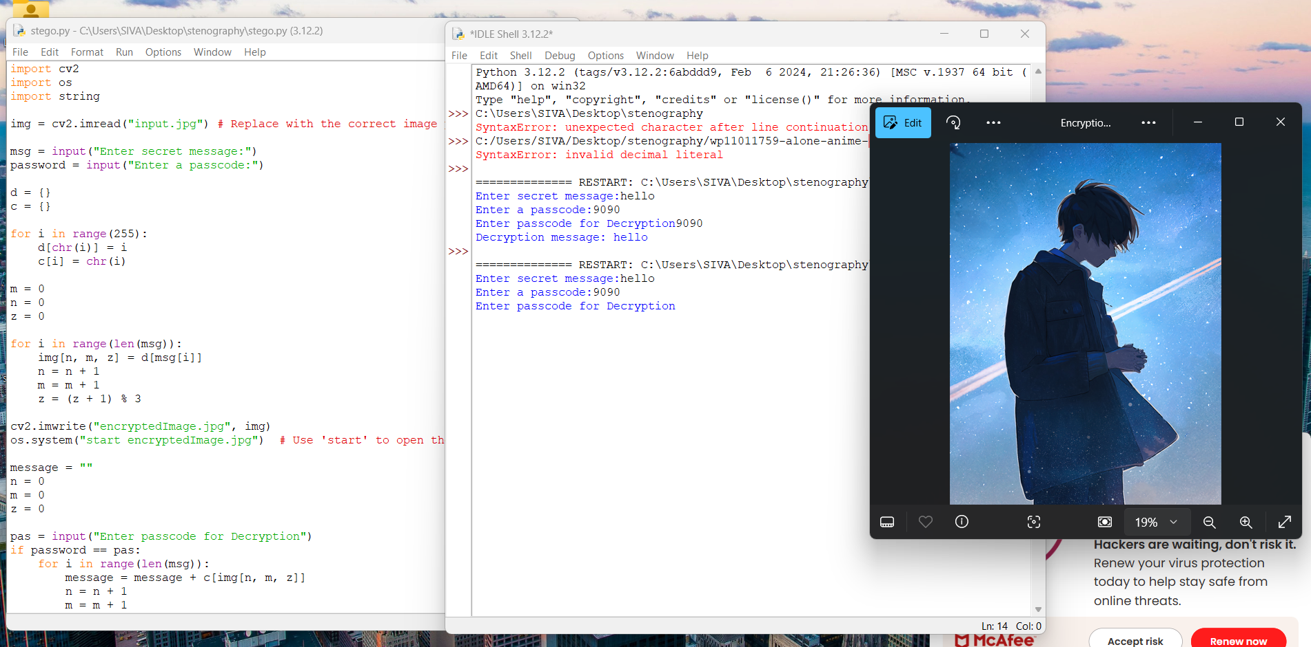
Results
Source Code:
Input Image File:
Output Image file:

Slide 8
Conclusion
This project successfully demonstrates the integration of encryption and steganography for hiding
secret messages in images.
By leveraging Python and OpenCV, this solution is simple, effective, and scalable for secure communication.
While this system is effective, it can be further enhanced with more complex encryption algorithms for
better security.

Slide 9
GitHub Link
https://github.com/ShadowFang077/Steganography_Project1.git

Slide 10
Future scope(optional)
Advanced Encryption: Implement stronger encryption algorithms (e.g., AES, RSA) to make the system even more secure.
File Size Optimization: Enhance the algorithm to support larger files or images while maintaining quality.
Cross-platform Implementation: Develop a graphical user interface (GUI) application for easier usage on multiple platforms (Windows, Mac, Linux).
Multi-layer Steganography: Hide multiple messages within a single image or use different colors to encode information.

Slide 11
THANK YOU

